Slide 1

Presentation of Jeffrey Gray’s book CONSCIOUSNESS creeping up on the Hard Problem Oxford University Press 2004
https://github.com/Brain-and-Consciousness/HBF
Boleslaw Srebro
Emeritus, Department of Biomedicine
University of Bergen
2028-08-26

Slide 2
Key aspects of Consciousness:
Awareness - being aware of yourself and your environment.
Subjective experience of the perceived objects (“qualia”), thoughts, and body states.
Attention and intentionality - focusing on specific experiences and their significance.
The recognition of oneself as a distinct entity (self-awareness, “I” experience).
?. . . . .
Key questions about consciousness:
What is the biological significance of consciousness?
How did consciousness develop in the evolution of the nervous system?
How does the human brain create both conscious and subconscious experiences?
What is the function of the subconscious “non-experience”?
How sensory systems “create” objects (qualia)?
When does consciousness appear in individual human development?
What is the role of language and thoughts in consciousness?
What is the relation between consciousness and memory?
Do animals have consciousness? Do they have self-awareness?
And many more questions…..

Slide 3
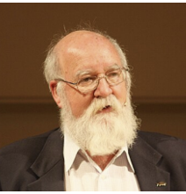
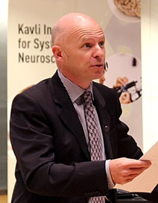
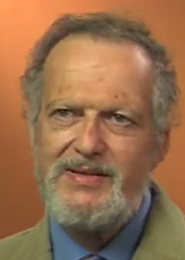
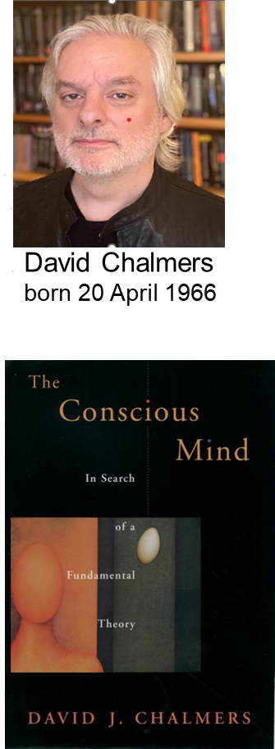
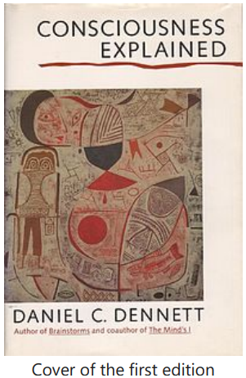
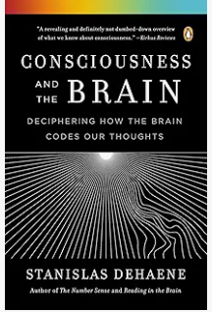
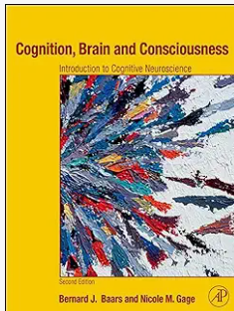
Some books on philosophy, psychology, and neurobiology of consciousness.
Daniel C. Dennett
(March 28, 1942 – April 19, 2024)
Stanislas Dehene
(born May 12, 1965)
Bernard Baars
(born 1946, Amsterdam)

Slide 4
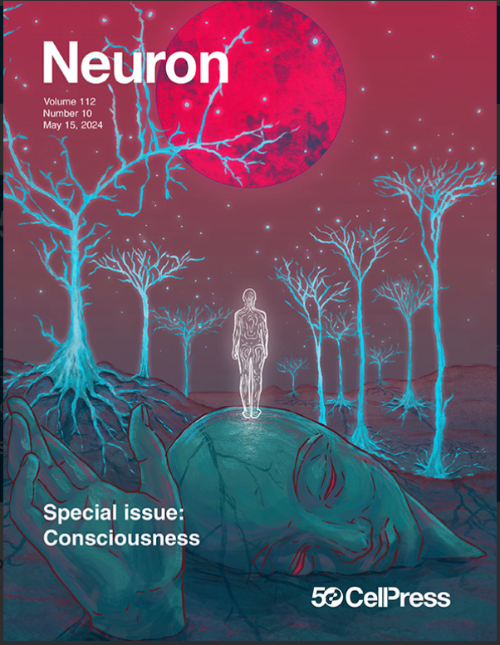
Recent publications on the neurobiology of consciousness.
Articles in the Special Neuron issue:
1. An integrative, multiscale view on neural theories of consciousness.
2. Anesthesia and the neurobiology of consciousness
3. Consciousness and sleep.
4. Thalamic contributions to the state and contents of consciousness.
5. An integrative view of the role of the prefrontal cortex in consciousness.
6. Taking consciousness for real: Increasing the ecological validity of the study of conscious vs. unconscious processes..
Neuron Special Issue, May 15, 2024 Volume 112, Issue 10
Recent reviews:
Anil K. Seth and Tim Bayne, Theories of consciousness.
Nature Reviews of Neuroscience, 23 July, 439–452, (2022).
Robert Lawrence Kuhn, A landscape of Consciousness: Toward a taxonomy of explanations and implications.
Progress in Biophysics and Molecular Biology 190, 28 -169, (2024)
Koch, C., Massimini, M., Boly, M. & Tononi, G. Neural correlates of consciousness: progress and problems. Nature Reviews Neuroscience,17, 307–321 (2016)

Slide 5
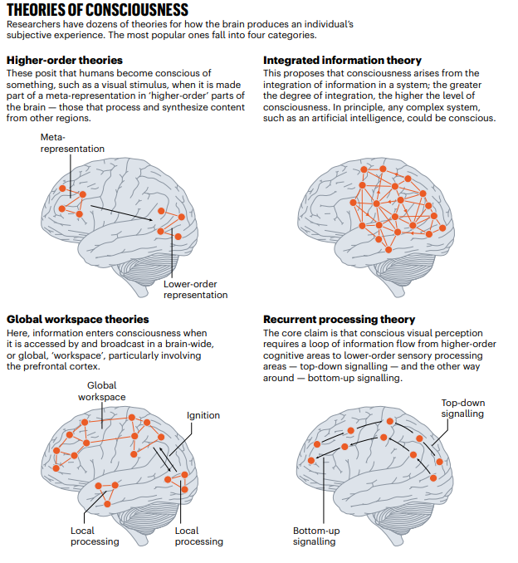
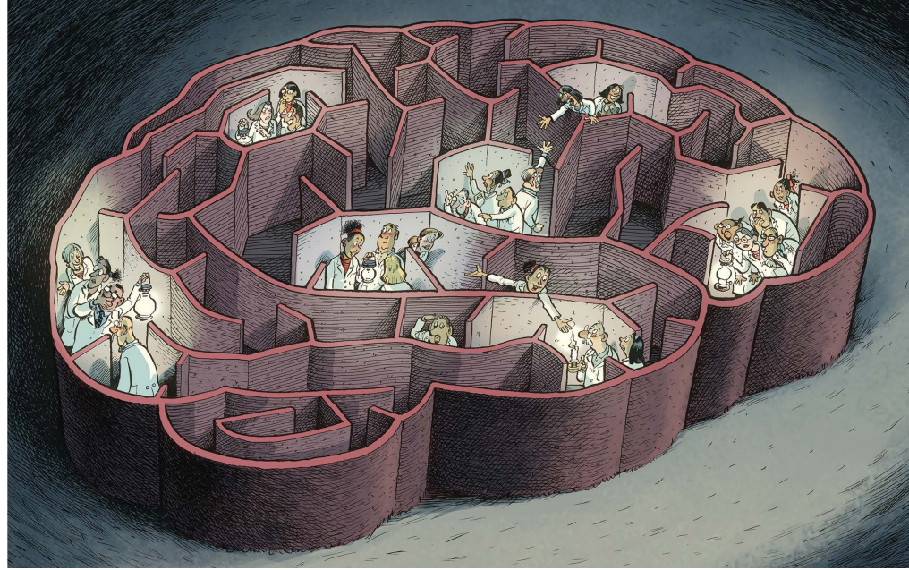
CONSCIOUSNESS: The future of an embattled field.
Mariana Lenharo, Nature | Vol 625 | 18 January 2024
|
Report from a Meeting in Allen Brain Institute, Seattle, USA.

Slide 6
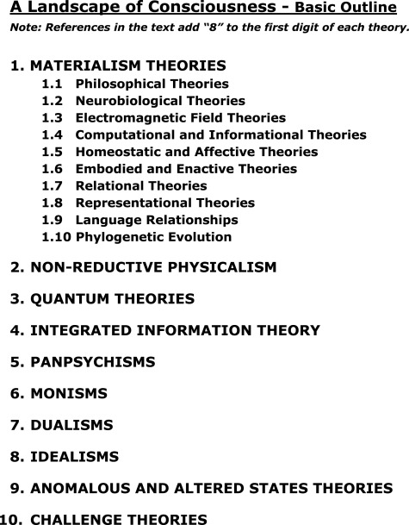
A landscape of Consciousness: Toward a taxonomy of explanations and implications.
Robert Lawrence Kuhn
https://doi.org/0.1016/j.pbiomolbio.2023.12.003
Abstract:
Diverse explanations or theories of consciousness are arrayed on a roughly physicalist-to-nonphysicalist landscape of essences and mechanisms. Each explanation is self-described by its adherents, critique is minimal and only for explanations, and there is no attempt to adjudicate among theories. The implications of consciousness explanations or theories are assessed for four questions: 1. Meaning/purpose/value (if any), 2. AI & Consciousness, 3. Virtual immortality, 4. Survival beyond death, A Landscape of Consciousness, suggests a new perspective in the field.

Slide 7
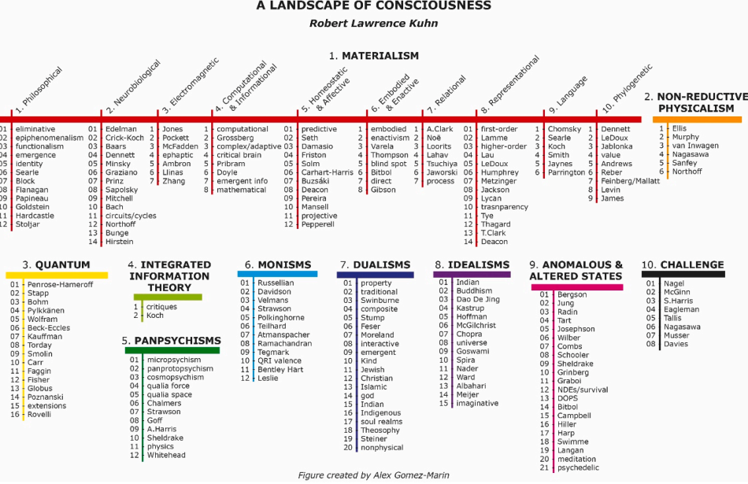

Slide 8
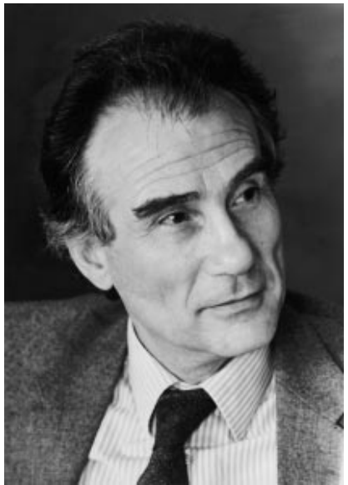
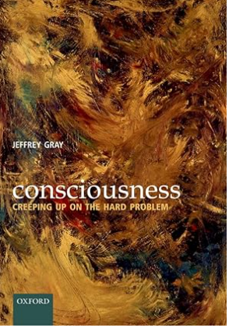
Jeffrey Alan Gray
Born: 26 May 1934, London, United Kingdom.
Died: 30 April 2004 (aged 69).
Nationality: British.
Alma mater: Magdalen College, Oxford (BA, BA), King's College London (PhD)-
Military service: 1952 - 1954 (Learned fluent Russian).
PhD Thesis: The relation between stimulus intensity and response
strength in the context of Pavlovian personality theory.
Fields: Clinical Psychology.
Known for: Gray’s biopsychological theory of personality.
Institutions: University of Oxford, Institute of Psychiatry, London.
Publications: 450 scientific articles, 8 books.
Most citations: The neuropsychology of anxiety, OUP 2000, 2nd. Ed.
The Septo-Hippocampal system. CIBA Symposium. London, 1977.
Languages: Fluent in 5 +1 languages.

Slide 9
Consciousness. Creeping up on the Hard Problem.
Abstract
How does conscious experience arise out of the functioning of the human brain? How is it related to the behaviour that it accompanies? How does the perceived world relate to the real world? Between them, these three questions constitute what is commonly known as the Hard Problem of consciousness. Despite vast knowledge of the relationship between brain and behaviour, and rapid advances in our knowledge of how brain activity correlates with conscious experience, the answers to all three questions remain controversial, even mysterious. This book analyses these core issues and reviews the evidence from both introspection and experiment. To many its conclusions will be surprising and even unsettling:
The brain constructs the entire perceived world. The relationship between the world we perceive, and the underlying physical reality is not as close as we might think.
Much of our behaviour is accomplished with little or no participation from conscious experience.
Conscious experience of our behaviour lags behaviour itself by around 350 milliseconds; we become aware of what we do only after we have done it.
The lag in conscious experience applies also to the decision to act; we only become aware of our decisions after they have been formed.
The “self” is as much a creation of the brain as is the rest of the perceived world.
Book content
Chapter 1: Stances towards the problem of consciousness.
Chapter 2 The illusory narrative of consciousness.
Chapter 3: Where science and consciousness meet.
Chapter 4 Intentionality.
Chapter 5 Reality and illusion.
Chapter 6 Enter Qualia.
Chapter 7 A survival value for consciousness?
Chapter 8: Creeping up on the hard problem.
Chapter 9 Epiphenomenalism revisited.
Chapter 10: Scrutinizing functionalism.
Chapter 11 From Cartesian theatre to global workspace.
Chapter 12 The global neuronal workspace.
Chapter 13 The neural correlate of consciousness.
Chapter 14 Bottom-up vs. top-down processing.
Chapter 15 Egocentric space and the parietal lobes.
Chapter 16: Taking physics seriously.
Chapter 17 Consciousness of self: the point of view.
Chapter 18 The bodily senses.
Chapter 19 Responsibility.
Chapter 20 Overview.

Slide 10
Chapter 1: Stances toward the problem of consciousness.
This chapter begins with a brief description of different spaces of conscious experience. It then distinguishes between the contents of consciousness and states of consciousness. This is followed by the discussion of the four different points of view (‘stances’) that one can adopt towards the problem of consciousness.
The first (‘naïve’) stance is taken by all of us before we have thought much about consciousness. This stance takes conscious experience for granted as the firm ground from which to approach all other problems.
The second (‘normal science’) stance is taken by a large number of scientists and philosophers, some of whom have thought about consciousness very little, others a great deal.
The third (‘new theory’) stance accepts the importance of these normal-science problems.
The fourth (‘non-scientific’) stance agrees with the new-theory stance that there is a Hard Problem, but rejects the likelihood that a solution to this problem will be found within science.
This book takes a version of the third, new theory stance: there is a Hard Problem, it is a problem for science, not philosophy, and it will almost certainly require a radically new theory for its solution.
Chapter 2 The illusory narrative of consciousness.
The archetypal story of conscious experience is told like this: perceived (consciously saw, heard, tested, etc.) this out there, and so I then did (consciously formed the intention to do, and so then did) that.. The chapter unpicks this story in the following ways:
The conscious perceiving does not precede the doing; it follows on after the doing, or at best goes parallel with it. (Libet experiment)
The “out there” of conscious experience isn’t out there at all; it is inside the head.
The conscious “I” is not the true subject of the story: it is the unconscious brain
Benjamin LIBET Experiment. The subject was instructed to make a hand movement (wrist or fingers) at the time of his own choosing. The subject was facing an oscilloscope, displaying a spot revolving around the screen like a second hand on a clock. When the subject first consciously decided to make a move, he was instructed to note the position of the spot on the oscilloscope, thus giving the time at which his decision was made.The EEG machine was recording the electrical activity on the scalp of his brain to detect the so-called readiness potential (a slow negative shift). The Libet experiment showed that the readiness potential (EEG negativity) occurs before the movement and the first conscious awareness of the intention to make a move. The delay between a negative change in EEG and conscious awareness of the intention to move was about 350 milliseconds.

Slide 11
Chapter 3 Where science and consciousness meet.
The arguments deployed here are primarily focused on facts regarding conscious experiences. This chapter continues that task by examining a broader theoretical picture: how does consciousness fit into the rest of the scientific worldview? how does consciousness fit into neuroscience?
The questions are:
How does brain activity give rise to consciousness and the contents of conscious experience?
How do consciousness and the contents of conscious experience influence behavior?
How did consciousness evolve?
4. What survival value does consciousness confer upon
those organisms that possess it?
Chapter 4 Intentionality.
The chapter examines the Hard Problem of consciousness at a finer level of detail by considering the nature of the gap between consciousness and brain activity. It argues that intentionality is attach to the processes that are achieved unconsciously. Thus, it is unlikely that a deeper scrutiny of the intentionality properties will lead ipso facto to a solution of the Hard Problem of consciousness.
Intentionality is the mental ability to refer to or represent something; it is regarded as a mark of the mental processes. It is found in mental states like perceptions, beliefs, or desires. For example, the perception of a tree has intentionality because it represents a tree to the perceiver. A central issue for theories of intentionality has been the problem of Intentional in-existence: to determine the ontological status of the entities that are the objects of intentional states (mental existence).
4.1 The binding problem.
4.2 Searle’s model.
4.3 The intentionality of conscious experience.
4.4 Unconscious intentionality?
4.5 Harnad’s model for categorical representation.
4.6 Fitting intentionality into biology.
The concept of intentionality was reintroduced in the 19th century by Franz Brentano (a German philosopher). Brentano described intentionality as a characteristic of all acts of conscious phenomena, by which they may be set apart from "physical" or "natural" phenomena. Brentano coined the expression "intentional inexistence" to indicate the peculiar ontological status of the contents of mental phenomena. According to some interpreters, the "in-" of "in-existence" is to be read as locative, i.e.as indicating that "an intended object exists in or has in-existence in consciousness”. Existing not externally but in the psychological state". Brentano’s philosophy is often called “phenomenology” (Wikipedia).

Slide 12
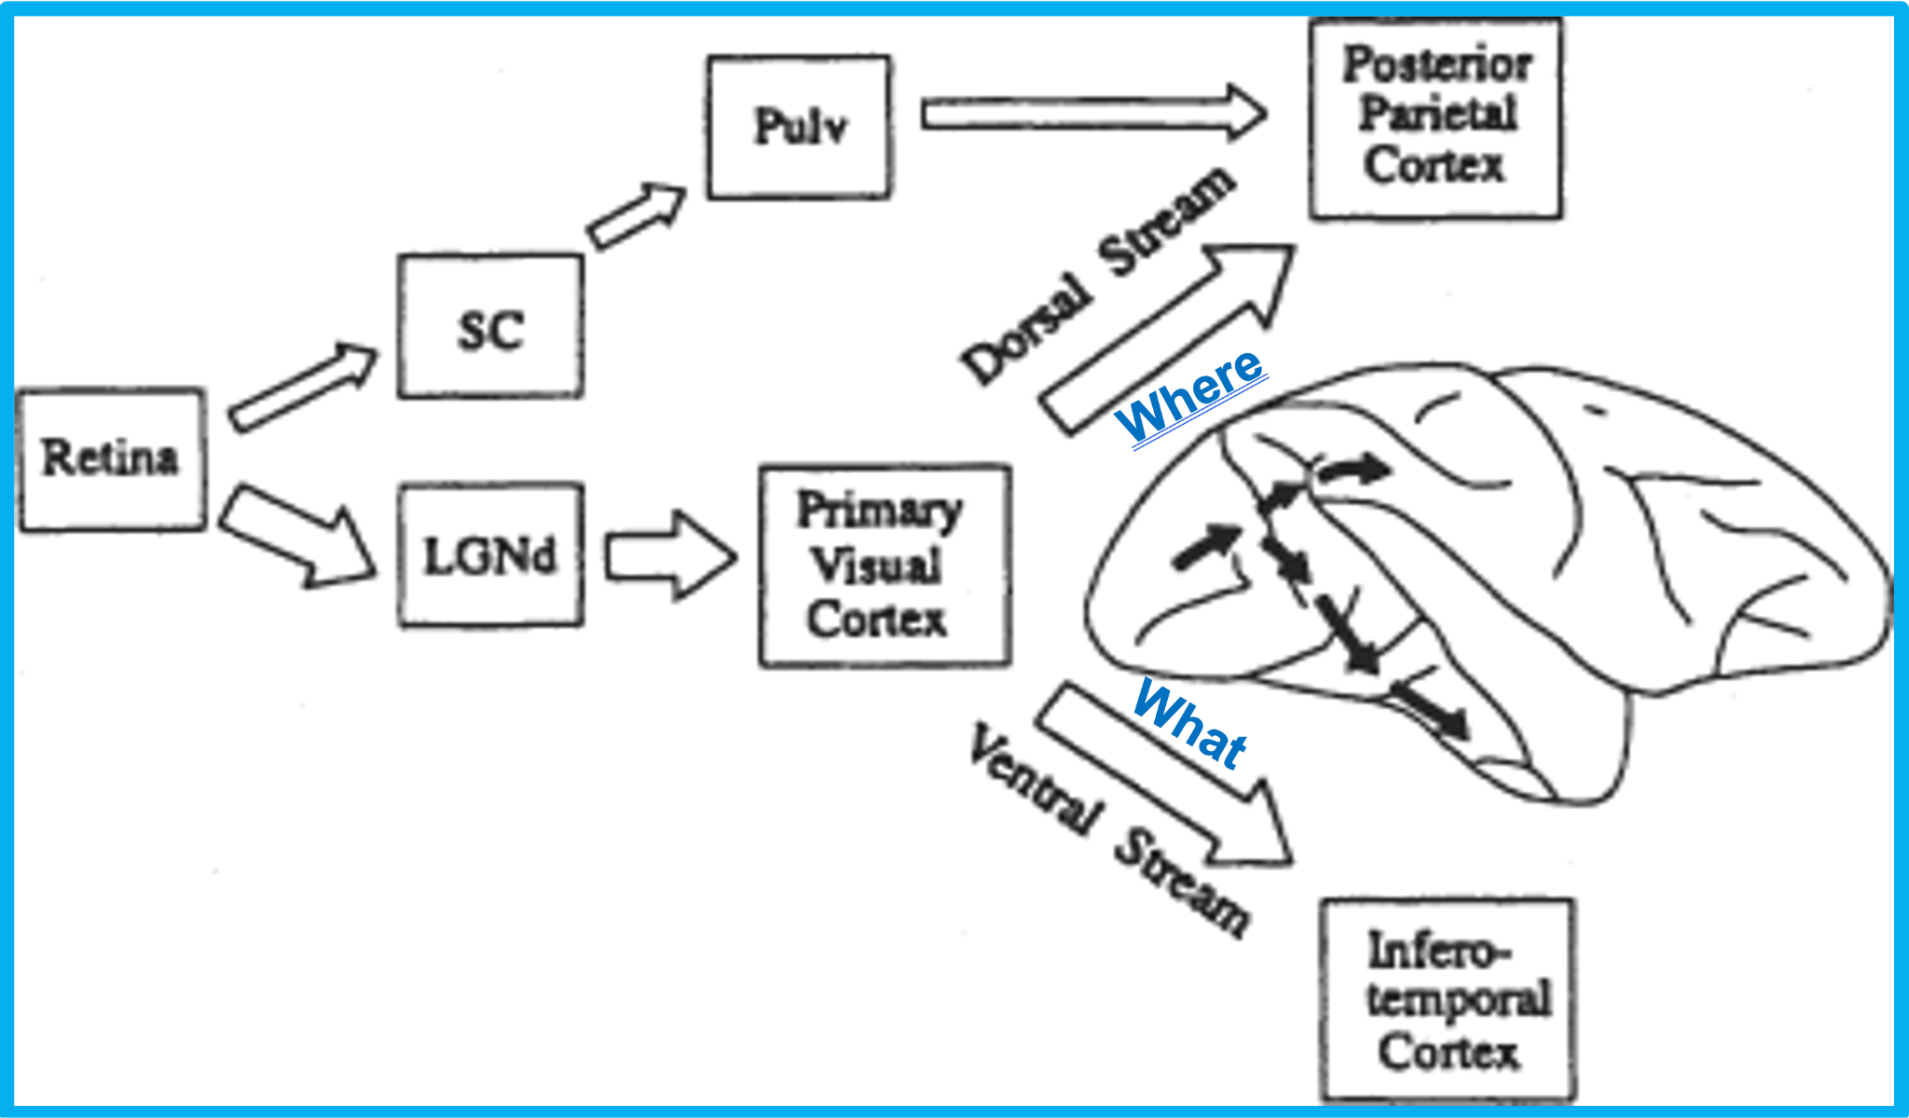
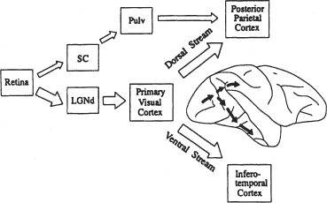

Chapter 5 Reality and illusion.
This chapter argues that although the brain devotes a remarkably high proportion of its overall capacity to vision, one point become clear: that much of our visual sense obscures the reality of the external world perceived by our senses, it is evident in the paradox of illusion. The primary phenomenon of illusion is created by conscious interference (interpretation) with perception based on previous experience.
5.1 The unreality of the external world.
5.2 The paradox of illusion.
Chapter 6 Enter qualia.
This chapter begins with a discussion of the heart of the problem of consciousness: qualia. It explores animal consciousness and shows that animals, particularly mammals, possess qualia, which rules out the need to take seriously suggestions that consciousness originated with the Greeks or requires human language, or that its survival value (through sexual selection) lies in its contribution to specifically human intelligence or artistic sensitivity. The chapter then considers the possibility that consciousness has no real function: that it is an epiphenomenon.
In philosophy, qualia are defined as instances of mental experience, as “mental objects”.(explanations of qualia involve the “binding problem”)
Daniel Dennett suggested that qualia were:
ineffable – they cannot be communicated or apprehended by any means other than direct experience.
intrinsic - they are non-relational properties, which do not change depending on the experience's relation to other things.
private – all interpersonal comparisons of qualia are impossible.
apprehensible by consciousness – to experience a quale is to know that one experiences a quale, and to know all there is to know about qualia
Where
What
Schematic diagram showing two major routes whereby retinal input reaches the dorsal and ventral streams.

Slide 13
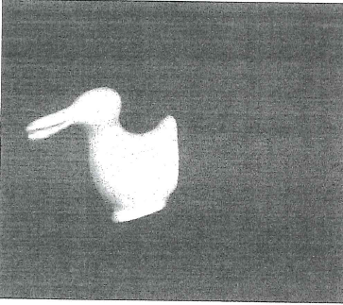
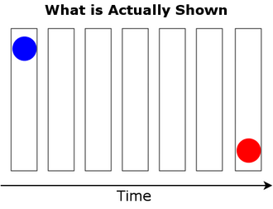
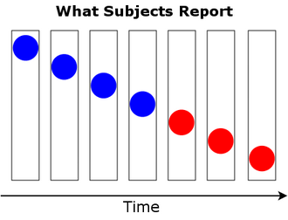



Perceptual illusions.
Phi-phenomenon
The "phi phenomenon" is a perceptual illusion where our brains perceive motion from a sequence of still images. When two still images are shown in rapid succession, our brains interpret the changing positions as continuous movement. This illusion is achieved by displaying images with a specific time gap (interstimulus period) between them, typically 30-200 milliseconds. This phenomenon is the basis of apparent movement in film.
Phi- phenomenon was discovered by a German psychologist Max Wertheimer, who studied sensation and perception. The phenomenon was demonstrated when two identical objects were presented in a rapid succession. The subjects experienced back and forth movement of presented objects. Wertheimer insisted that the brain fills in the space between stationary objects to create the illusion. Thus, the reality of perception is interfered with by “conscious interpretation”.
Duck/rabbit ambiguity
Phi-phenomenon
Color Phi-phenomenon
50 -100 msec
Time delay
A
B
Illusion
A
A
A
A
A
A
B
An apparent movement of the object A to to the position of object B
First described by Paul Kolers and Michael von Grünau illusion of apparent motion is induced between objects with different colors. The objects are displayed with 50 msec delay, and the color of the apparently moving object abruptly changes midway along the path.

Slide 14
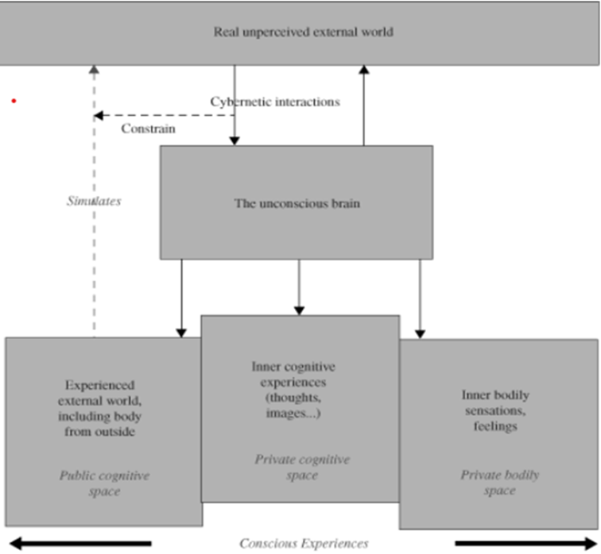
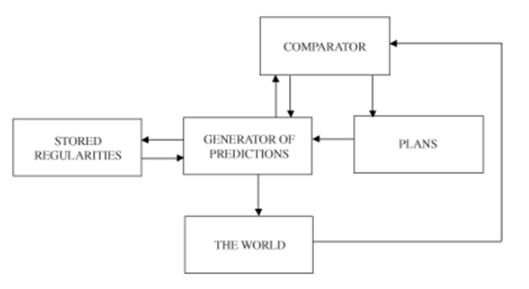
Chapter 7. A survival value for consciousness?
Any account of the survival value of conscious experience must respect its lateness relative to the behaviour it accompanies. Most existing proposals as to the functions of consciousness ignore this constraint. In consequence, they posit the role of this function on the evidence that it is discharged unconsciously before consciousness comes into play. This chapter focuses on the author's hypothesis, which explicitly takes the lateness of conscious experience as its point of departure.
Three ideas have been sketched in this chapter:
Conscious perception aids Darwinian survival by providing means for late error detection.
A central component of the machinery that achieves late error detection is a general-purpose comparator system;
(3) Perception constructs a model of the real world on a time base slower than the sensorimotor action systems function.
These ideas will be further developed and integrated in the next chapter, which presents the main lines of a general theory of the survival value of conscious experience.
Chapter 8. Creeping up on the hard problem.
This chapter first sets out a series of starting assumptions that any theory of consciousness will need either to make them or to choose between them. It then sketches a (partial) theory based upon these assumptions. It proposes that a key function of consciousness is to permit, in the simulated ‘real world’ medium of perceptual experience, the juxtaposition and comparison of variables controlled by different unconscious servomechanisms. These are in different sensory modalities that any single servomechanism has at its command.
Consciousness
Private space
Public space
Bodily space
The constructed world of consciousness could be divided into three different spaces: “public cognitive space”, “private cognitive space” and “bodily cognitive space ”
The kind of information processing required for the successful functioning of the comparative system

Slide 15
Chapter 9. Epiphenomenalism revisited.
Anyone who claims causality for consciousness has to offer at least some kind of explanation of how this might be achieved. This chapter explains the meaning of the term consciousness as a ‘medium’. It appears that the Hard Problem of consciousness can be stripped down to one (still Hard) but double-edged question: how does the unconscious brain create and inspect the display medium (qualia) of conscious perception?
This is considered one question rather than two because any scientifically acceptable account of how the brain creates qualia will at the same time constitute an account of how it inspects them. . What is certain is that the first half of the question, ‘how does the brain create qualia?’, is enough to keep science going for a long time to come.
9.1 Causality and consciousness.
9.2 Language, science, aesthetics.
9.3 Ongoing causal efficacy for consciousness?
9.4 The evolution and ontogeny of consciousness.
Chapter 10. Scrutinizing functionalism.
The previous chapter concluded by asking the question: How does the unconscious brain create and inspect the display medium of conscious perception? If the argument so far is correct, the Hard Problem of consciousness can be reduced to just this question. This chapter starts on the exploration of some possible ways to answer it.
10.1 Foreclosures.
10.2 Conscious computers?
10.3 Conscious robots?
10.4 Functionalism.
10.5 Experiments on synaesthesia.
10.6 Function vs tissue.
10.7 Implications of synaesthesia for functionalism.
10.8 The alien colour effect.

Slide 16
Chapter 11. From Cartesian Theatre to global workspace.
A neuroscientist first observes experimentally that a particular brain region or system discharges a specific function, which, in normal human experience, is associated with consciousness. He concludes that this region or system plays an important role in consciousness. But, in whichever direction the logic proceeds, the validity of the conclusion is entirely dependent upon the assumption that a particular function is critical for, or critically dependent upon, conscious experience. All the neuroscientist adds is a location in the brain (human or animal) where the putatively critical function is discharged.
Location throws little light on the problem of consciousness. The neuroscientific trail then, at least as at present trodden, leads at best to a three-way set of correlations: (1) between functions, (2) brain regions or systems that mediate the functions, and (3) conscious experiences. This chapter explores this terrain in a little more detail.
11.1 Is there a Cartesian theatre?
11.2 An egalitarian brain?
11.3 Executive functions.
11.4 The global workspace.
Chapter 12. The global neuronal workspace.
This chapter argues that the global workspace aspires to be a good isomorph of what conscious experience feels like. But one of the things that conscious experience feels like is a display that one can inspect. The most dramatic of these displays does not lie in the ‘private spaces’ of consciousness — the words, numbers, images, etc. that we can call to mind and which executive functions manipulate in relative isolation from the world outside. It lies, rather, in that very world outside.
There is an audience looking at, listening to, smelling, tasting, and touching the effects, in consciousness, of the dynamic patterns that have won out in the competition for the global workspace. But the concept of the workspace gives no clue as to how this is done, and consideration of its neuronal underpinnings has done nothing to advance matters in this respect. Nor, for that matter, once its dualism is stripped away.
. 12.1 The common communication protocol.
12.2 Some neuronal specifics.
The concept of Cartesian theatre originates from the idea of Cartesius, who claimed that consciousness is localized only in one part of the brain, the epiphysis (pineal gland) located in the center of the brain.

Slide 17
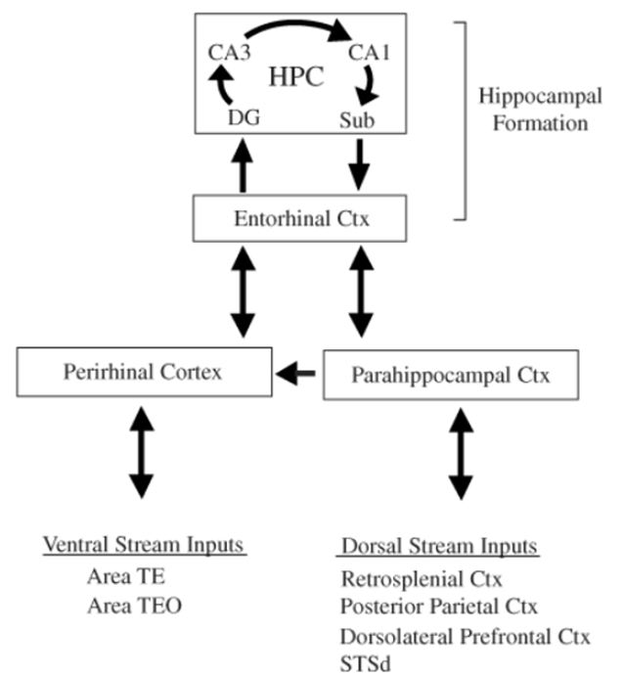
Chapter 13. The neural correlate of consciousness.
This chapter explores the neural correlate of consciousness (NCC), a phrase coined by Francis Crick, which describes the neural activity that is proximal to any particular form of conscious experience. Crick’s interest lies in the NCC of specifically visual awareness. Crick asks the question: what is the proximal activity underlying the visual qualia of colour, motion, shape, etc.?
This emphasis on vision is driven, not theoretically, but practically, since so much more is known about this sense, both psychologically and physiologically, than any of the others. However, there is no reason to think that a solution found for the NCC of vision would apply in principle to the other senses.
Crick's approach implies that there will be multiple foci of neural activity, each proximal to a different type of qualia. In particular, NCCs should be found in perceptual systems (since one is consciously aware of percepts) but not in systems whose operation does not figure in conscious awareness, such that control motor behavour (walking, balance, eye movement, etc.).
13.1 Activity in V1 and visual awareness.
13.2 The frontal Connection.
Chapter 14. Bottom-up vs. top-down processing.
The approaches to the neural basis of conscious experience considered in the three previous chapters sway between two seductive sirens: one calling down from the top, the other calling up from the bottom. Top-down processing emphasizes executive functions located in the frontal lobes, as in the global neuronal workspace, while bottom-up processing emphasizes the posterior cortex modules that mediate the basic ingredients of perception. This chapter looks at the possibility that both approaches are correct but need to be combined in ways we have not yet considered.
14.1 Bottom-up and top-down combined.
14.2 The hippocampus.
14.3 Hippocampal function and consciousness.
Neural basis of the allocentric space
Sensory input to parahippocampal areas feeds information to the hippocampal formation.

Slide 18
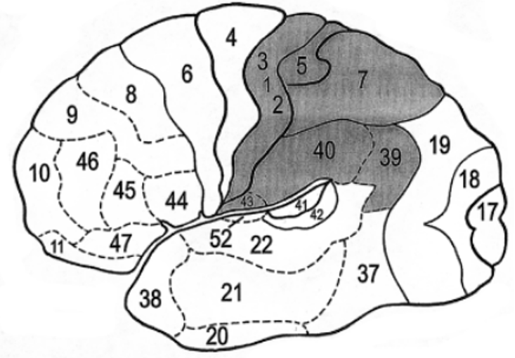
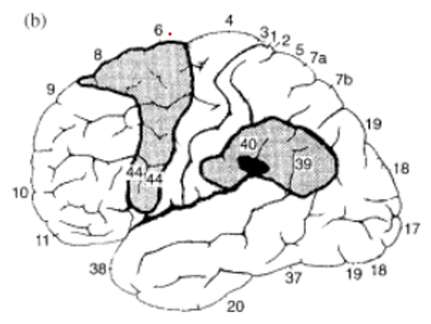
Chapter 15. Egocentric space and the parietal lobes.
The previous chapter emphasized the importance of an allocentric, or world-centred, spatial frame for conscious experience, and this was one reason for concentrating so heavily on the hippocampus. This chapter considers another kind of spatial frame — egocentric, or body-centred, space — that is also intimately related to conscious experience. This frame is computed, not in the hippocampus, but in a neocortical region: the parietal lobes.
15.1 Spatial neglect.
15.2 Balint’s syndrome.
15.3 Putting space together.
15.4 The role of V1 in veridical perception
Chapter 16. Taking physics seriously.
This chapter shows that the Hameroff–Penrose theory of how different quantum superpositions in microtubules in different brain areas give rise to different qualia. This theory must rely for the origin of these differences on arguments taken from neuroanatomy and neurophysiology. And, despite its intricate Gothic architecture, the theory is incomplete. It offers no account of how differences at the Planck scale might relate to differences between qualia; nor of how differences in space/time in one brain might relate to differences in another brain observing the same scene at the same time. Nonetheless, the theory does offer an account in principle of the origin of differences in qualia..
16.1 The Gestalt principles.
16.2 The Penrose–Hameroff theory.
16.3 Quantum computation.
16.4 Objective reduction of the quantum wave function.
16.5 Descending into the quantum brain.
16.6 Psychophysical isomorphism.
16.7 Whence qualia?
I have no comments on this chapter due to my lack of knowledge of the
particle physics, although I agree with Jeffery Gray’s conclusion that
confining the same quantum superposition in the molecular memory mechanism to all kinds of neurons in the brain is probably wrong or at least controversial.
The lateral view of the human brain showing Brodmannʼs cortical areas. The parietal areas are shaded. b) The syndrome of spatial hemineglect: anatomical correlates (grey areas). A damage in this area produces Balini’s syndrome.

Slide 19
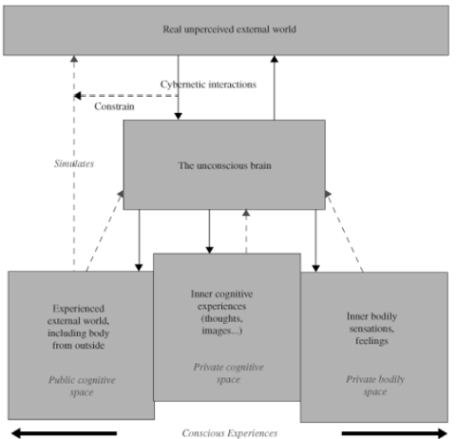



The three private spaces contributing to the conscious brain.
Integrated consciousness
Private space
Public space
Bodily space
Bodily space
The different spaces of conscious experience. In brief, the brain interacts unconsciously, continuously and cybernetically with the real, unperceived, external world. The constructed world of consciousness can be divided into three ʻspacesʼ: the ʻpublic cognitive spaceʼ, containing the experienced external world, including the body as perceived from the outside; the ʻprivate cognitive spaceʼ, containing inner cognitive experiences such as thoughts, memories and images; and the ʻprivate bodily spaceʼ, containing inner bodily sensations and feelings.
Perilous proximity to dualism. A modification to Fig. 1.1 (dashed lines going back up to ʻthe unconscious brainʼ) to illustrate the possibility that conscious experience might have causal effects on the activities of the unconscious brain in its own right (that is, over and above any effects of the neural activity that gives rise to the conscious experience).

Slide 20
Chapter 17. Consciousness of self: The point of view.
The feverish modernity, in the last few chapters, of neuroscience and quantum mechanics has perhaps obscured the hoary antiquity of the problems we are dealing with, the nature of consciousness, and the reality of the external world. The questions tackled in this chapter are no less hoary. They keep steady company with the Hard Problem. Whose consciousness is it anyway? What is this mysterious “self”? to which conscious experiences it is automatically attributed?
17.1 The point of view.
17.2 Belongingness.
Chapter 18. The bodily senses.
The previous chapter considered the sense of self as being made up of a point of view (computed in the parietal lobes) and belongingness (computed in the hippocampal system). These processes both require the construction in consciousness of a model of the external world. The point of view requires the construction of a map of egocentric space; and the sense of belonging requires semantic and associative interpretation of current sensory input. This chapter considers an aspect of the sense of self that offers a sharp contrast. It is concerned, not with the external world, but with states of the body; and it lacks that hallmark of cognitive processing, intentionality. It is argued that core consciousness (consciousness of bodily states and the emotional reactions that reflect these states) does not differ radically from cognitive consciousness in terms of brain location. Both depend for their proximal neural correlates upon activity, not in the brain stem, but in the neocortex (however, core consciousness does differ sharply from cognitive consciousness in its general lack of intentionality).
18.1 Intentionality revisited.
18.2 Emotion.
18.3 Signals of error?
18.4 Core consciousness?
My comment: In recent years there is more information available on the localization of a “bodily space”. It appears that the Insula in the human brain receives significant amount of the autonomic, sensory and emotional information, suggesting that this part of the cortex may play similar role as the Parietal Cortex for the egocentric space.

Slide 21
Chapter 19. Responsibility.
The previous two chapters looked at a number of different aspects of the sense of self: the point of view, the feeling of belongingness and the emotional self of the body. This chapter considers one final aspect of the sense of self: the sense of agency (belongingness-mediation). The sense of agency is the ‘I’ of ‘the archetypal narrative of consciousness’ described it in Chapter 2, or what Daniel Dennett calls ‘the center of narrative gravity’.
19.1 The sense of agency.
19.2 The concept of responsibility.
Chapter 20. Overview.
This final chapter may be as good a place to start as the beginning of the book. For this reason, it is written as a relatively self-contained overview of the entire argument, not necessarily following the order in which particular ideas emerged earlier. Inevitably, as befits an overview, there will be some repetition of material that has gone before. But it also introduces a small amount of new material, if it seems to fit best here.
20.1 The problem: qualia and only qualia.
20.2 Reduction.
20.3 The function of conscious experience.
20.4 Where does the brain create qualia?
20.5 Enter quantum mechanics.
Last words.

Slide 22
The main conclusions of the book.
Gray's book begins with a presentation of some of the classical and problematic issues of conscious experience: the existence of qualia in perception and intentionality. He concludes that qualia are an inherent property of perceptual experience based on a higher level of integration in the sensory systems and, possibly, on memory of prior sensory experiences (interference in illusions). The neural basis of qualia is still an unresolved problem (in sensory physiology, it is called “the problem of binding”). Intentionality is defined as a property of the representation of real and abstract objects. According to Gray, intentionality is the subconscious attribution of meaning based on previous experience.
The biological significance of consciousness is conferred by Gray to the process of “the late error detection”, based on experimental evidence that conscious experience lags after behavior, which is subconsciously decided and executed. Consciousness basically has the monitoring function, providing feedback to the neural systems, to compare the execution of behavior with a plan, a goal, and motivation. This is a new idea on hypothetical function of consciousness. It also applies to the biological role of consciousness in animals.
The last and new hypothesis of Gray postulates the existence of three main domains of consciousness: public space, bodily space, and private space. Each of them has a subconscious part, and they provide their content to the integrated consciousness experience. The public space provides allocentric and egocentric sensory information. The bodily space provides information about the internal state, emotions, and motivation. The private space contains mental processes: language, thoughts, images, and individual memory. ‘
In my opinion, this division facilitates the search for neural correlates of consciousness as well as tracing the phylogenetic development of consciousness. The bodily space is localized in the subcortical parts of the brain, and it has developed at the early stages of brain evolution. The public space evolves with complex movements, social interactions, and spatial orientation (navigation). Most likely, it is present to a different degree in all vertebrates. The private space developed as a result of neocortical expansion (frontal lobes) and the new brain functions (language).
I hope that Jeffrey Gray’s book has provided you with a unique and sophisticated view of the road up to the Hard Problem. It is still a long way to go for neuroscience. Thank you for your attention.

